Slide 1
Information ENCODING STANDARDS Final Project
Aleena Saji - 200475553

Slide 2
Part-1

Slide 3
Explain how JWT is used in API security
JSON Web Tokens are commonly used in different phases of API security. It's a JSON Object that's used to send data securely over the internet. The fundamental benefit of JWT is that every token is independent, implying that it contains all data expected to permit or deny any offered solicitations to an API.
It can be utilized as part of an authentication system. It has the potential to build or confirm the trust connection between two parties sharing data, as well as allow for the assertion of the associated identity.

Slide 4
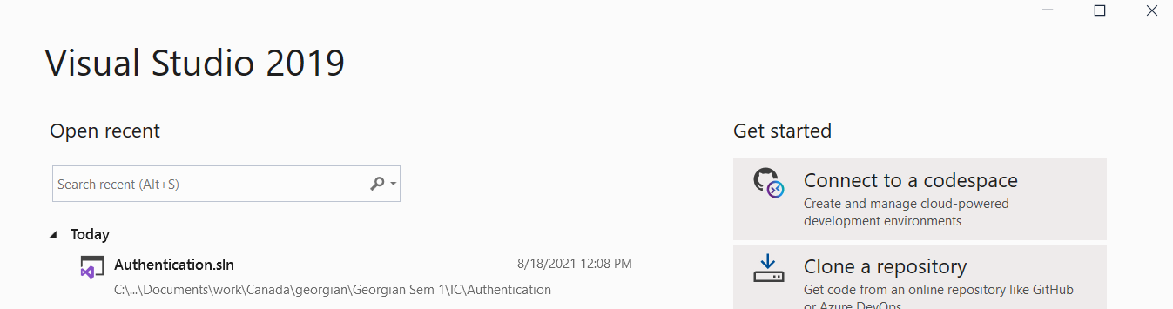
created asp.net core web application

Slide 5
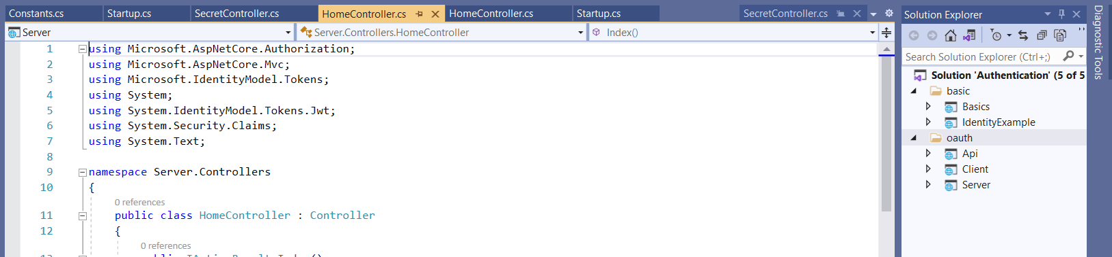
Output

Slide 6
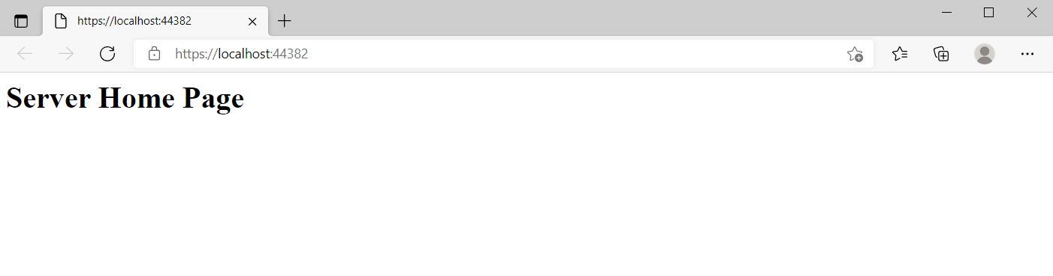
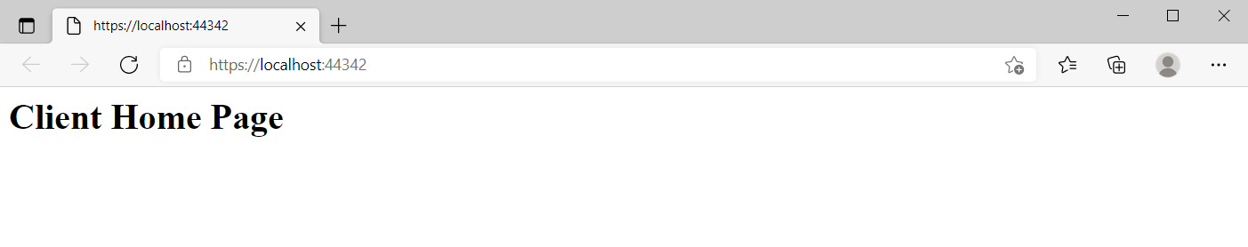
Output

Slide 7
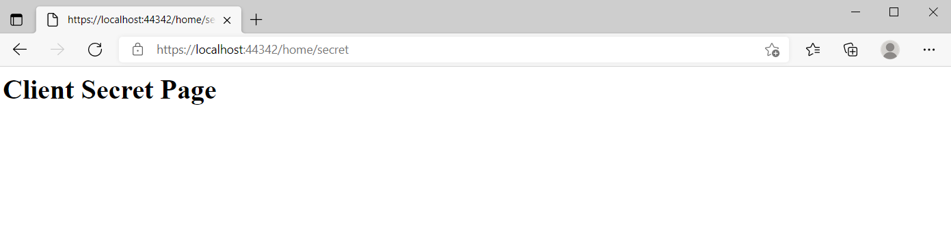
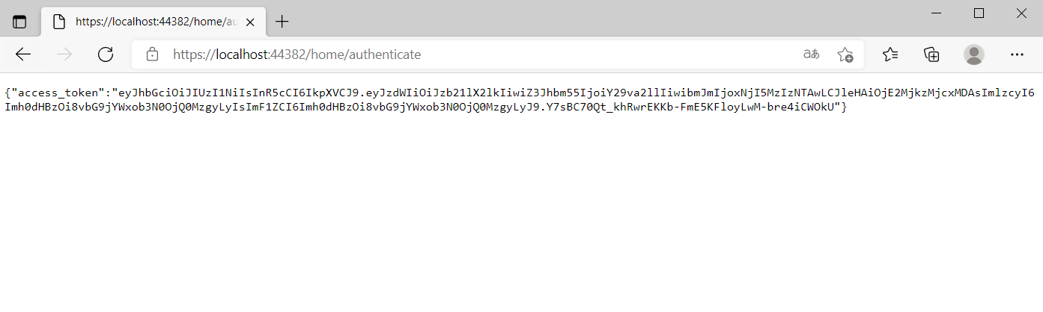

Slide 8
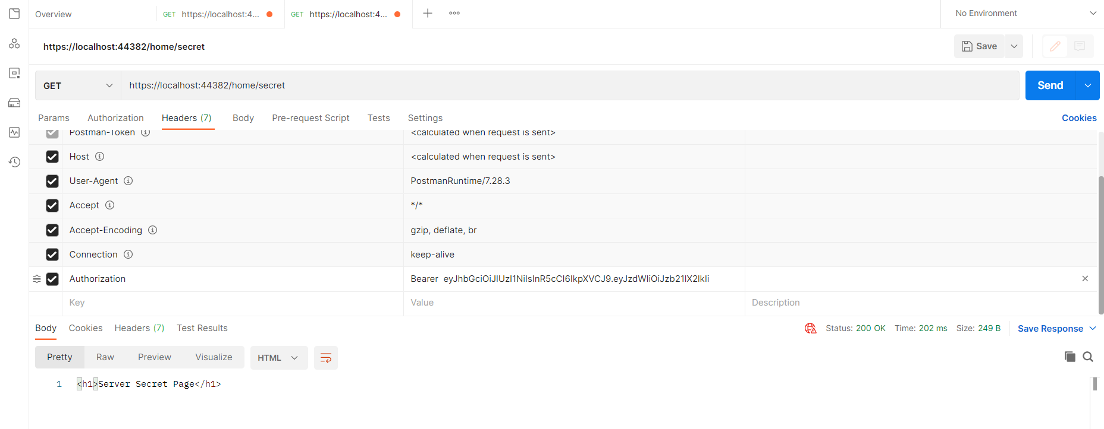
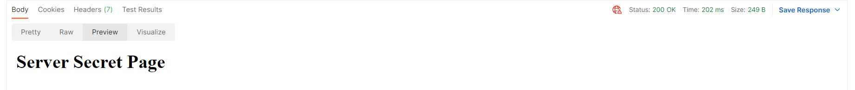
Postman

Slide 9
Make a recommendation on which choice of Authentication method (OAuth, OpenId, or other) is best for API security
Oauth
The most typical OAuth implementations use either an access token or a refresh token, or both. The application uses an access token to gain access to the user's data, however these tokens can expire. If the tokens have expired, refresher token may be used to obtain a new access token.
It allows for the creation of scopes that can grant access to different parts of the API service, and because the token is revoked after a set period of time, it is much more difficult for attackers to re-use.
It is the greatest option for recognizing user accounts and assigning access to them.

Slide 10
Part-2 Security technologies recommendation
A local Hospital is asking for you to act as a consultant on a project. They have some questions that they hope you can answer:

Slide 11
How can we transfer personal data securely within their network?
A great number of files are shared everyday using email, WhatsApp, FTP tools and so on.
The need to protect sensitive data has increased over the years with advance in technology. A great number of files are transferred through different channels within and outside the any organization daily. With the busy schedule people often don’t stop to analyze the security level offered by that means of data transfer.
Common means of transfer are:
Email – no user authentication or guarantee of data encryption.
FTP (File transfer Protocol) – lacks significant security features
HTTP – no user authentication or data encryption.
For the transfer of personal data securely within the Network use:
The SSH ( Secure shell)
is a set-up of projects and conventions.
can be used for exceptionally configurable approach to move information securely and encode information streams from less secure projects.
guarantees encryption in transit but not at rest.
Require asymmetric authentication or password.

Slide 12
What security policy is best for transferring personal information?
Most data transfer protocols employ SFTP, which is the most widely used protocol. A complicated password and SSH keys are used in SFTP's more private dual authentication method. In addition to Linux, SFTP is available for Windows and Macintosh systems. Using the Secure File Transfer Protocol with NIST methods offers the highest protection (SFTP).

Slide 13
Can we encode and encrypt images?
Numerous encryption algorithms can be used to encode and encrypt photos. Third-party encryption tools can be used to mix random pixels in images according to computational logic, and then decode the image using the same logic at the receiver's end. Alternatively, we might use the techniques to construct our own tool using encryption and decryption algorithm.

Slide 14
Our database cannot be moved from the site, and we need to be able to access it externally using a secure API ?
REST API can be considered.
Anytime an external API is used to retrieve the data, we must ensure that data is accessed safely and correctly.
The architecture for a secure API is built such that we may transition our backend and frontend work securely to a cloud service.

Slide 15
Can you recommend a secure framework for coding an API?
A secure framework must consider Authorization. The PUT and POST methods also have to include input validation, or else the integrity of the network would be at risk. Security and privacy should be included into a framework while creating an application.

Slide 16
What data interchange format should we use while transferring data between locations?
Java Script Object Notation can also be used to transport information from one location to another (JSON). Even though this is a Java script plug-in, then it is not dependent on the operating system as a whole. Programming and updating are basic tasks that anybody can do. A substitute for xml files, because xml files are difficult to generate and comprehend.

Slide 17
How should we store our data in our many locations?
We can replicate the data over numerous servers in different places.
RDBMS may be used at any moment to get the data. When recording at several locations, the Oracle database's replicating and grouping features may be needed. That way, data is more reliable and harder to manipulate

Slide 18
What are the ethical concerns related to the transmission of personal data?
Third parties who are not authorized should not have access to information. Every bit of information should be kept. Prioritizing security and avoiding confidentiality breaches is essential. In the event of a technological failure, approved information should not be leaked out.

Slide 19
Link
Presentation: https://drive.google.com/file/d/1at20J7PmLQx5ioRkZ3bRvmr9nr6FJrCT/view?usp=sharing
https://github.com/Saji-Aleena/Aleena-BDAT1001-FinalProject

Slide 20
THANK YOU
Credits: Ms. Nital Shah

